Slide 1

Graduation project
Bachelor Informatics
Coordinators:
Dr. Dolly Sapra
Dr. Chrysa Papagianni

Slide 2

Graduation project Bachelor Informatics
can already do do:
Read the manual on Canvas Make sure that everyone is familiar with the content !
Put the timetable in your calendar See manual and “Course summary” on the main page on Canvas.

Slide 3
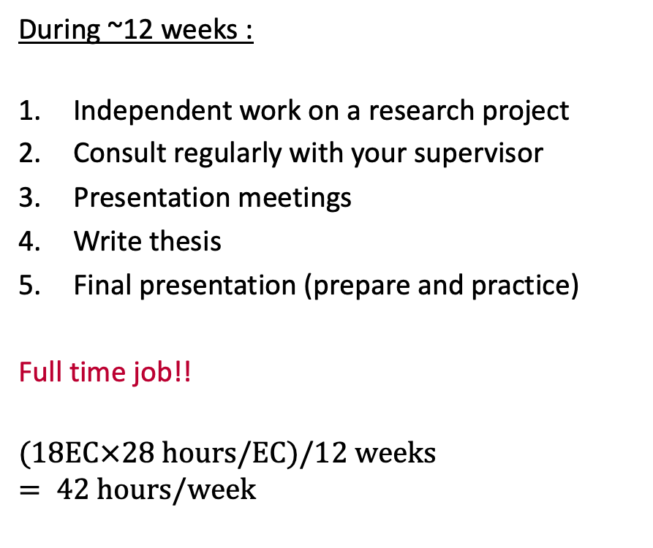
Graduation project Bachelor Informatics
During ~12 weeks :
Independent work on a research project
Consult regularly with your supervisor
Presentation meetings
Write thesis
Final presentation (prepare and practice)
Full time job!!
$$(18\text{EC}×28 \text{hours}\text{/}\text{EC})/12 \text{weeks}= 42 \text{hours}\text{/}\text{week}$$
“The purpose of the graduation project is for the students to demonstrate that they can independently carry out a research project and thus gain (basic) research experience.”

Slide 4
1. Independent work on a research project
55% of the final grade
Under the supervision of a teacher/researcher
Phases:
Literature study
Design
Implementation
Experiments/simulations etc.
Documentation: thesis
Tips:
You are a process manager
Talk to others about your project; get your thoughts in order
Keep a log!
Describe each day what you did / thought of you have , even the trivial - obvious stuff
Access to science publications : UvAVPN

Slide 5
2. Consult regularly with your supervisor
1 hour per week
Ask for / adjust project with your supervisor
Discuss intermediate thesis versions
Tips:
You are the project manager
Be proactive ! Use the consultation time useful :be prepared to explain
What have you done since the last meeting?
What questions do you have?
What are you going to do till next time ?

Slide 6
3. Presentation meetings
Once a week on Tuesday, 2 hours
Everyone should attend!
Progress presentations from you and your fellow students
Every presentation gets a short review (not graded)
From three fellow students
Format : 10 minutes + 5 minutes
English or Dutch (English in class)
Everyone presents once! (Schedule to follow)
Possibility to ask questions
Tips:
Learn from your fellow students
Tips from and for fellow students
Actively ask questions

Slide 7
4. Write thesis
30% of the final grade
Must be sufficient to be allowed to give a final presentation
Two assessors: supervisor and second reader
Honors: third assessor
Bachelor's level academic document
Impeccable spelling, grammar and punctuation
Discuss interim versions with supervisor
Language:
Honors: English
Other: Dutch or English
In consultation with supervisor
Tips:
Start on time!
Fail thesis means: insufficient for graduation
Please note: log ≠ thesis !
Write each day half an hour
Read scientific papers /books etc.; that helps when writing the thesis
See UvA thesis database for examples of theses from previous years

Slide 8
5. Final presentation
(Schedule: soon )
15% of the final grade
Only if thesis is found sufficient
For supervisor, second reader , examiner, fellow students , family and friends
15min + 5min Q+A
Committee deliberation
Final grade
Tips:
Use the feedback on presentations during the plenary meetings

Slide 9

Final grade
55% implementation (determined by supervisor )
30% thesis (supervisor + second / third reader )
15% final presentation : (supervisor + second / third reader + examiner)

Slide 10
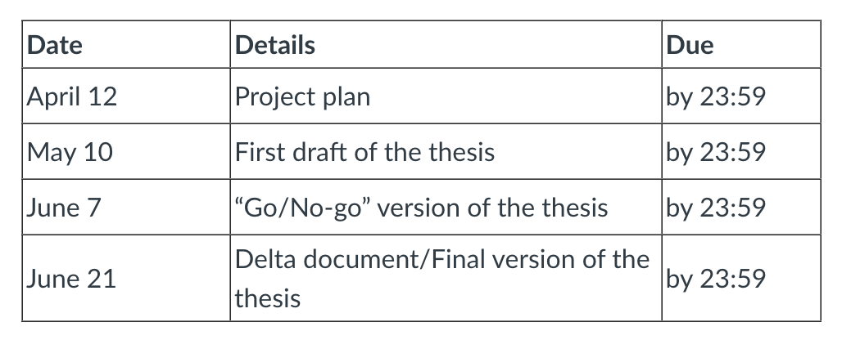
Intermediate deliverables
See deadlines on Canvas and in the manual
Project plan (deadline: next Friday !)
First draft of the thesis
“Go”/”No-go” version of the thesis
Final version + delta of the thesis

Slide 11

What now?
Does everyone have an appointment with the supervisor?
Discuss : what is required for the assignment ?
What should you read ?
What do you need ?
How are you going to work ?
How often and where you meet your supervisor?
Compile project plan
See manual: “ A project plan is a clear elaboration of the graduation assignment and describes the action plan for the entire graduation project”
Submit on Canvas: see deadline
Must be approved by your supervisor!

Slide 12
Project plan: research question
Not necessarily “ yes or no”
Think about how your goal can be achieved. If you are going to carry out an implementation, for example: What is the main challenge of this implementation ? How can ... be solved efficiently be ? How accurate can … simulated be ?
Be careful with how you formulate the question!
“What does an implementation of a website look like that provides a user-friendly environment that ...”
Then you also need to test whether the website is really user-friendly, which can take a lot of time.

Slide 13
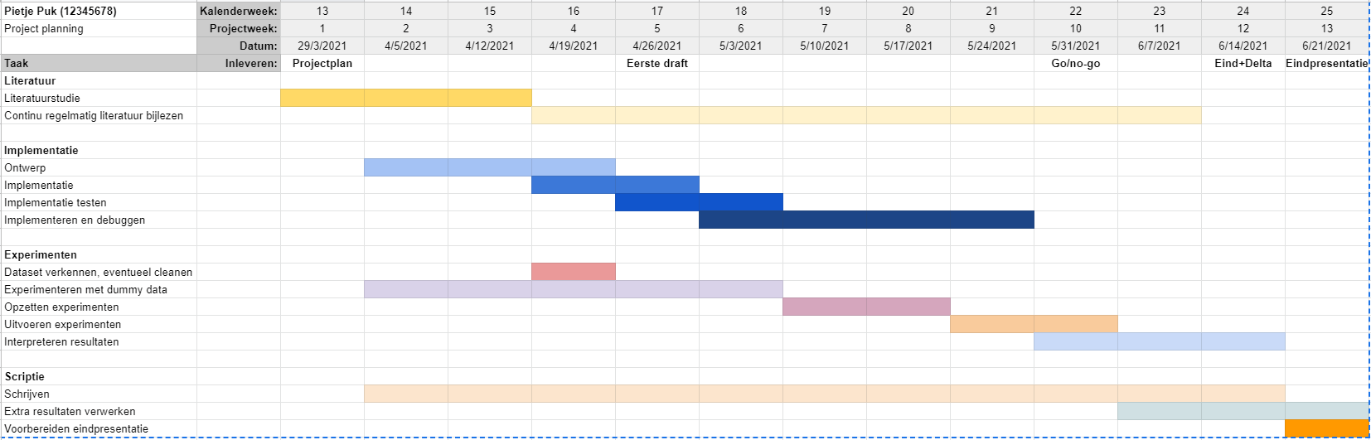
Project plan: planning
Important part of one project plan
Example (Gantt chart):
Notes:
Not shown on March 29 , 2016; but this has Michael van der Werve made for his graduation project 2015/2016.

Slide 14
Project plan: assessment
After handing it in gets everyone three project plans sent , and an assessment form
Goal: insight into how your fellow students approach their project
Not graded / updates based on comments do not need to be submitted..
But take the tips into account! The project plan is ultimately for the success of your own project.

Slide 15
Tips
Is something going wrong? Let us know!
Run experiments in parallel with implementation
Plan B if data is not available
Be flexible: adjust research question if it proves to be too hard (in consultation with supervisor)
Common mistake: not enough time allocated for writing the thesis, allow at least a month
Common mistake: hiding when things are not going well

